Slide 1
Visualising Internal and International Migration in Great Britain, 2002-2013
Dr Jon Minton
AQMEN Research Fellow
University of Glasgow
Jonathan.Minton@Glasgow.ac.uk

Slide 2
Introduction
International net migration is a very visible political topic in UK
Reducing international net migration to the ‘tens of thousands’.
Definitions
Net migration = in-migration – out-migration
Migration = internal migration + international migration
So four types of migration
Migration propensities vary with age

Slide 3
Introduction
Different places have different age structures
Stock and flow: Births, movements, and deaths
Differences between countries
Differences between regions within countries
Dependency ratios
Working age
Children and elderly people
Age structure within working age

Slide 4
Introduction
Great Britain (England, Wales, and Northern Ireland) is a very spatially unequal developed world country, with a very pronounced North/South divide
Unlike people, migration means regions can ‘age’ at more or less than one year per year
This itself can affect – reproduce, attenuate or amplify – social and economic spatial inequalities

Slide 5
Aim of this research: To visualise…
…. migration flows in the context of population structure
… differences between regions
… the contribution of migration flows to maintaining and altering population structure
… the influence of both population structure and migration flows to regional differences and their persistence over time in the UK

Slide 6
Methods: Data Sources
England & Wales
Office for National Statistics
Components of Change: workings towards small area population estimates
Births & deaths: Civic registrations
Internal migration: NHS registration
International migration: population surveys and airport surveys
Scotland
National Registers of Scotland
Similar methodology

Slide 7
Data visualisation
Using the ggplot2 package (Wickham)
Inspired by the ‘grammar of graphics’ paradigm (Wilkinson)
Data vis are made of layers: support, data, annotation
Data layer (Necessary but not sufficient): Mapping from variables (columns) in datasets to graphical aesthetics (colour, size, position and so on)
Also inspired by trellis plot (Cleveland)/ small multiple (Tufte) approach
Tables of figures using the same aesthetics

Slide 8
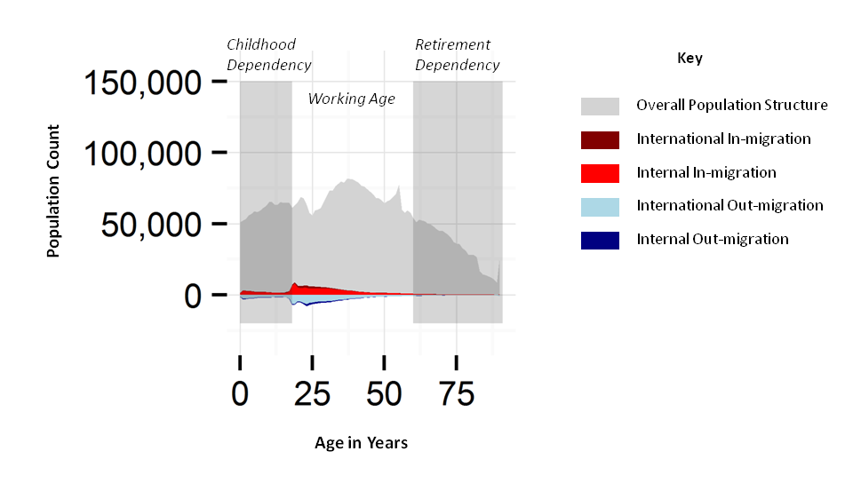
Anatomy of a single tile

Slide 9
Results
All results as a single tile
Good for printing on walls as large as possible
All results in a PDF
good for flicking through like a simple animation

Slide 10
Discussion
London and the rest
Demographically: London, South East & South West are like one country, and the rest of England, and Wales, and Scotland, are like another
International Migrant journeys Through London:
Successful migrant journey: Abroad (0-22)-> London (23-30)-> South East (28-40)
Less successful migrant: Abroad (0-22) -> London (23-35) -> Abroad
International (and internal) migrant journals through rUK
Go to university, leave university

Slide 11
Discussion
Relatively high balance between in-migration and out-migration in most of GB, except London
Only London has large proportions of international in-migration compared with internal in-migration and population structure
Scotland
Like Wales, but slightly more persistence of migration propensity with age, and higher rates international in-migration

Slide 12
Final thoughts
The Immortal South and the Ageing North
The South is a magnet for internal as well as international migration
Contributes to spatial persistence of regional inequalities in GB
Substantive implication
More prosperity, more migration
Misdirected ire? Less migration, more fear of migration
Methodological implication
Tens of thousands of data points at a glance
Why limit a data visualisation to the dimensions of a screen, when we have walls?!
Thanks for listening!
Jonathan.Minton@Glasgow.ac.uk

